Slide 1
DNA→RNA→protein
The genes contained here
Tell us how to make these

Slide 2
Remember first semester
We talked about DNA (a nucleic acid) first semester.
RNA is the other main nucleic acid

Slide 3
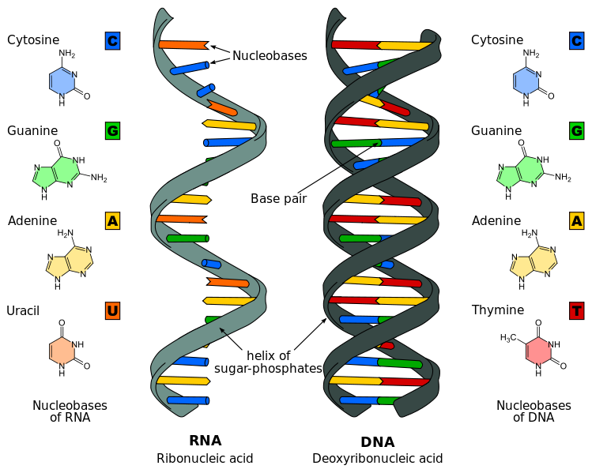
Structure of RNA
Differences:
Ribose versus deoxyribose
Thymine vs uracil
Double vs single stranded

Slide 4
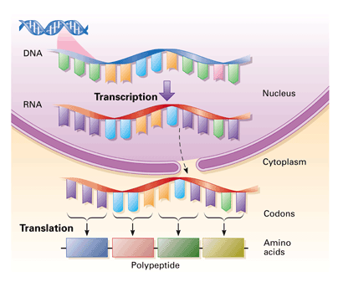
transcription
translation
DNA→RNA→protein

Slide 5
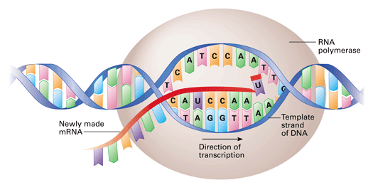
Transcription
G pairs with C
A pairs with U

Slide 6
Concept Check
A piece of DNA has the sequence GGATCCTA
If RNA polymerase reads this DNA to turn it into RNA, which will the sequence of the RNA that is made be?

Slide 7
Concept Check
A piece of DNA has the sequence GGATCCTA
If RNA polymerase reads this DNA to turn it into RNA, which will the sequence of the RNA that is made be?
CCUAGGAU

Slide 8
transcription
translation
DNA→RNA→protein

Slide 9
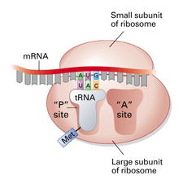
Translation

Slide 10
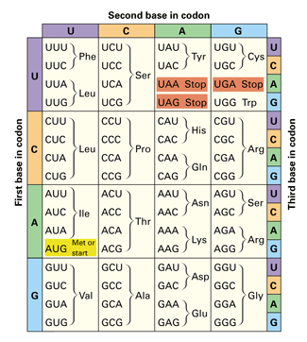

Slide 11
Concept Check
An mRNA molecule has the sequence:
AGA-UUU-CGA-UGC
What sequence of Amino acids will be made from this mRNA?

Slide 12
Concept Check
An mRNA molecule has the sequence:
AGA-UUU-CGA-UGC
What sequence of Amino acids will be made from this mRNA?
Arg-Phe-Arg-Cys

Slide 13
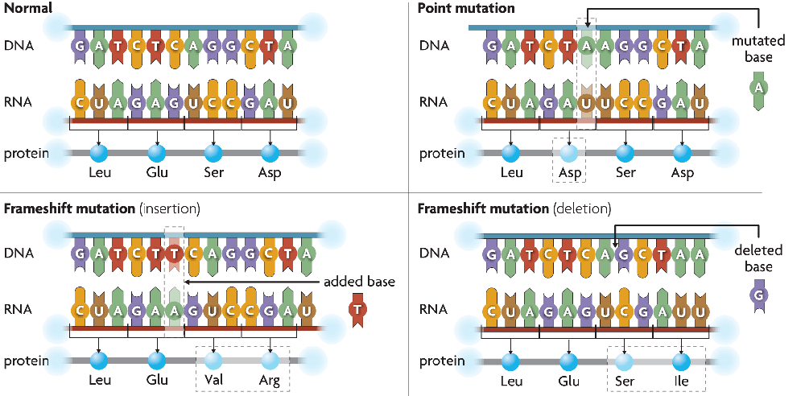
Mutations
A change in the DNA sequence
Can alter codons to make wrong protein
Possible causes: mutagens, errors in cell division, errors in DNA replication

Slide 14
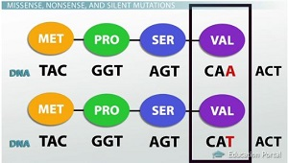

Slide 15
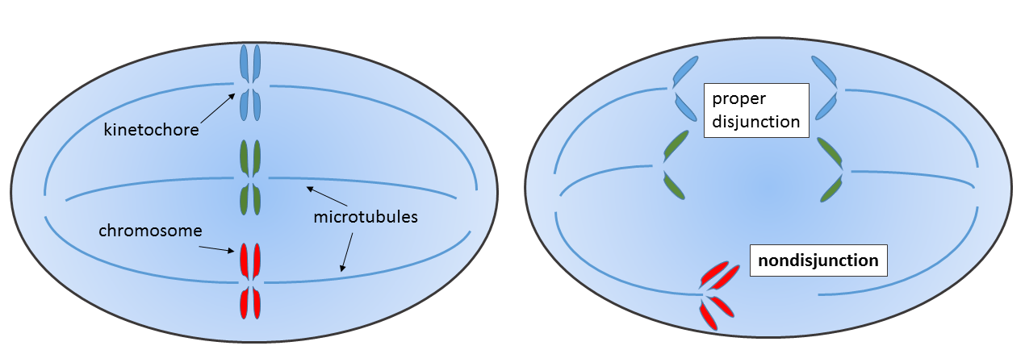
Large scale “mutations” Nondisjunction

Slide 16
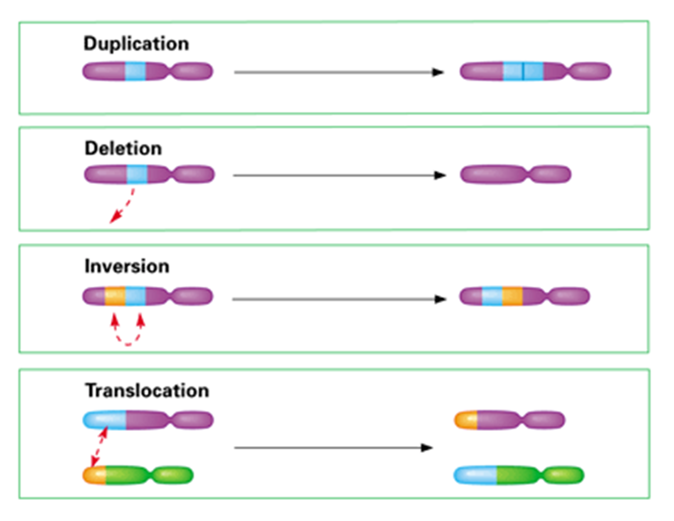
Large scale “mutations” Rearrangements

Slide 17
Concept Check
An mRNA molecule has the sequence:
AGA-UUU-CGA-UGC
What sequence of Amino acids will be made from this mRNA?
Arg-Phe-Arg-Cys
If the highlighted G is changed to a C, what effect would this have on the protein?

Slide 18
Concept Check
An mRNA molecule has the sequence:
AGA-UUU-CGA-UGC
What sequence of Amino acids will be made from this mRNA?
Arg-Phe-Arg-Cys
If the highlighted G is changed to a C, what effect would this have on the protein?
Arg-Phe-Arg-Ser

Slide 19
Not all mutations are bad…
Some have no effect
And some can actually be beneficial – remember these are the driving force for evolution

Slide 20
Cellular Differentiation and Stem Cells
If all the cells in your body have the same DNA, why aren’t all cells identical?
Because different genes are being used in different types of cells

Slide 21
Cellular Differentiation and Stem Cells
If all the cells in your body have the same DNA, why aren’t all cells identical?
Because different genes are being used in different types of cells

Slide 22
Biotechnology
Why do we genetically engineer DNA?
Can get desired DNA to study
Can make healthier, resistant crops
Can get things like bacteria to produce human proteins much faster than humans can

Slide 23
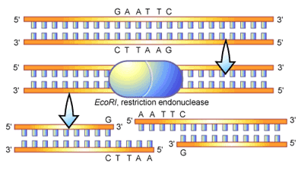
Biotechnology
Restriction enzymes – cut DNA

Slide 24
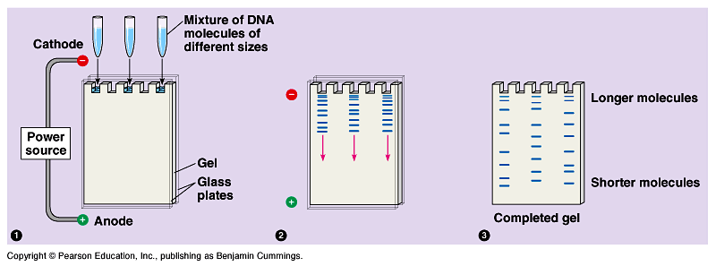
Biotechnology
Gel electrophoresis – use charge to separate DNA fragments based on size

Slide 25
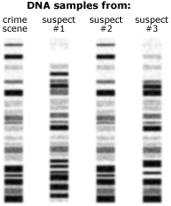
Concept check
Which suspect committed the crime?

Slide 26
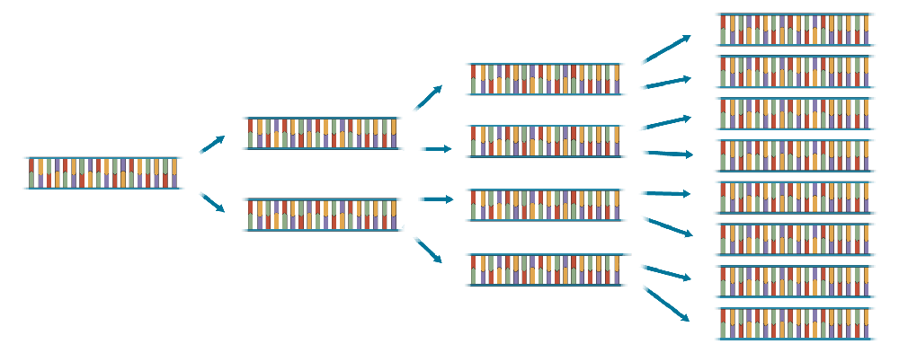
PCR
Make many copies very quickly

Slide 27
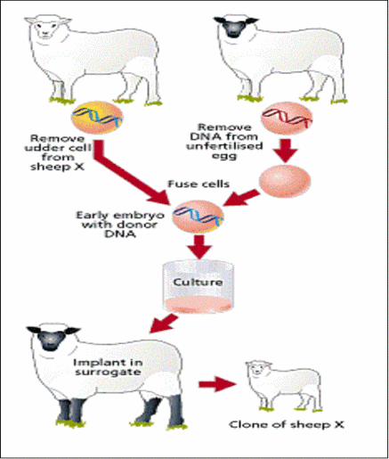
Whole animal cloning

Slide 28
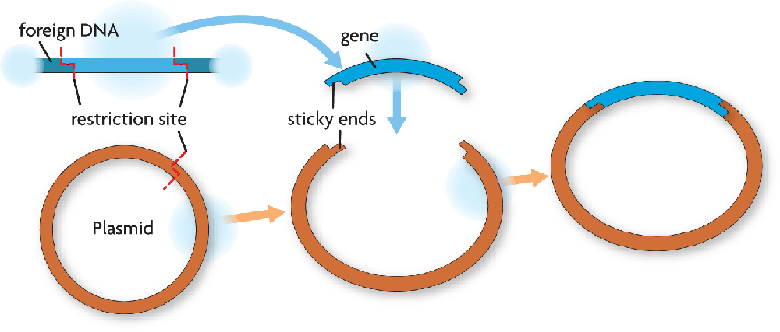
Gene Cloning

Slide 29
The Human Genome Project
Step 1: Get it sequenced
Step 2: Use the information
Identify new genes
Determine what new genes do
Compare genome to that of other organisms

