Slide 1
Jeopardy!
Fall Final Exam (Part II)
Edition

Slide 2
Cellular Respiration

Slide 3
Photosynthesis

Slide 4
Food Webs

Slide 5
Mitosis

Slide 6
Meiosis

Slide 7
DNA Replication

Slide 8
Final Exam Jeopardy
Cellular
Respiration
Photosynthesis
Food Webs
Mitosis
Meiosis
DNA
Replication
100
100
100
100
100
100
200
200
200
200
200
200
300
300
300
300
300
300
400
400
400
400
400
400
500
500
500
500
500
500
Final Jeopardy!

Slide 9
$100 Question
This is the cell organelle where cellular respiration occurs in plants and animals.

Slide 10
$100 Answer
What is the mitochondria?

Slide 11
Return

Slide 12
$200 Question
This is the form of energy that is produced through cellular respiration.

Slide 13
$200 Answer
What is ATP?

Slide 14
Return

Slide 15
$300 Question
Because cellular respiration requires oxygen, it is referred to as this type of process.

Slide 16
$300 Answer
What is an aerobic process?

Slide 17
Return

Slide 18
$400 Question
Unlike cellular respiration, fermentation does not require this.

Slide 19
$400 Answer
What is oxygen gas?

Slide 20
Return

Slide 21
$500 Question
This is the overall equation for cellular respiration.

Slide 22
$500 Answer
What is
?

Slide 23
Return

Slide 24
$100 Question
This is the cell organelle where photosynthesis occurs in plant cells.

Slide 25
$100 Answer
What is the chloroplast?

Slide 26
Return

Slide 27
Daily Double
Daily Double!

Slide 28
Daily Double Question
The process of photosynthesis converts this into chemical energy.

Slide 29
Daily Double Answer
What is light energy?

Slide 30
Return

Slide 31
$300 Question
During the day, plants are likely to be giving off this gas.

Slide 32
$300 Answer
What is oxygen?

Slide 33
Return

Slide 34
$400 Question
This is the overall equation for photosynthesis.

Slide 35
$400 Answer
What is
?

Slide 36
Return

Slide 37
$500 Question
This is where one would find the carbon atoms from CO₂ after photosynthesis has occurred.

Slide 38
$500 Answer
What is glucose (sugar)?

Slide 39
Return

Slide 40
$100 Question
This is an organism that can make its own food.

Slide 41
$100 Answer
What is an autotroph (or producer)?

Slide 42
Return

Slide 43
$200 Question
This type of organism is known for eating detritus and gaining energy in this way.

Slide 44
$200 Answer
What is a decomposer?

Slide 45
Return

Slide 46
$300 Question
This is how energy moves in an ecosystem.

Slide 47
$300 Answer
What is “flows”?

Slide 48
Return

Slide 49
$400 Question
This refers to each step in the food web/chain.

Slide 50
$400 Answer
What is a trophic level?

Slide 51
Return

Slide 52
$500 Question
CO₂ is released in numerous ways throughout the carbon cycle. This way, along with the process of cellular respiration and the burning of fossil fuels, are common ways to add CO₂ to the atmosphere.

Slide 53
$500 Answer
What is decomposition?

Slide 54
Return

Slide 55
$100 Question
This is the phase within the cell cycle where the DNA is replicated.

Slide 56
$100 Answer
What is interphase?

Slide 57
Return

Slide 58
$200 Question
This is the amount and ploidy of the cells created through the process of mitosis.

Slide 59
$200 Answer
What are 2 diploid cells?

Slide 60
Return

Slide 61
Daily Double
Daily Double!

Slide 62
Daily Double Question
When a single-celled organism reproduces by duplicating itself in a process similar to mitosis, it is referred to as this type of reproduction.

Slide 63
Daily Double Answer
What is asexual reproduction?

Slide 64
Return

Slide 65
$400 Question
Two identical chromosomes attached to a centromere are referred to as this.

Slide 66
$400 Answer
What are sister chromatids?

Slide 67
Return

Slide 68
$500 Question
This is when the chromosomes are condensed and visible during the cell cycle.

Slide 69
$500 Answer
What is during mitosis and cytokinesis (or the mitotic phase)?

Slide 70
Return

Slide 71
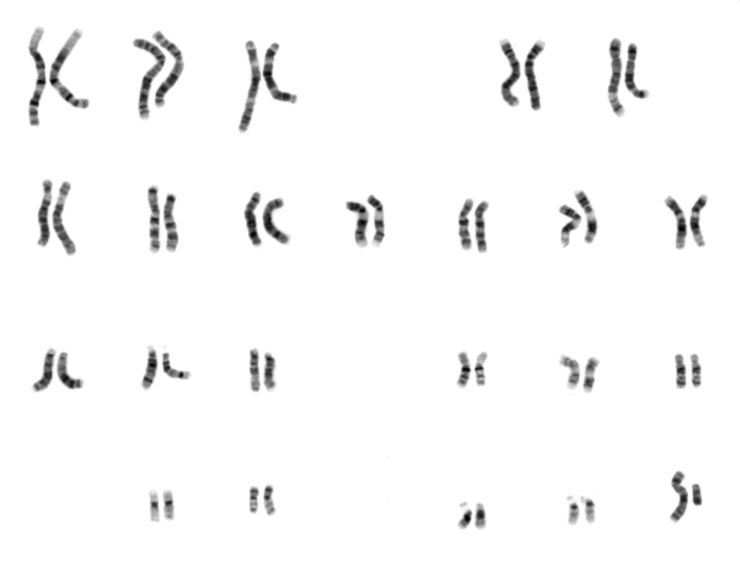
$100 Question
The karyotype pictured here is the karyotype of a human of this gender.

Slide 72
$100 Answer
What is a male?

Slide 73
Return

Slide 74
$200 Question
This is the amount and ploidy of the cells created through the process of meiosis.

Slide 75
$200 Answer
What are 4 haploid cells?

Slide 76
Return

Slide 77
$300 Question
This can be credited for the genetic diversity that is found among sexual organisms.

Slide 78
$300 Answer
What is crossing over?

Slide 79
Return

Slide 80
$400 Question
Through the process of fertilization, a zygote is created through the joining of these.

Slide 81
$400 Answer
What are two gametes?

Slide 82
Return

Slide 83
$500 Question
This is one of the many differences between the process of mitosis and meiosis.

Slide 84
$500 Answer
What is _________ (answers will vary)?

Slide 85
Return

Slide 86
$100 Question
This is the complementary strand to the DNA strand reading CTAGGCAT.

Slide 87
$100 Answer
What is GATCCGTA?

Slide 88
Return

Slide 89
$200 Question
The structure of DNA is referred to as this.

Slide 90
$200 Answer
What is a double helix?

Slide 91
Return

Slide 92
Daily Double
Daily Double!

Slide 93
Daily Double Question
The monomer unit of a nucleic acid is called this.

Slide 94
Daily Double Answer
What is a nucleotide?

Slide 95
Return

Slide 96
$400 Question
The process of DNA replication using one side of the parent DNA strand to make the new daughter DNA strand is referred to as this.

Slide 97
$400 Answer
What is the template mechanism?

Slide 98
Return

Slide 99
$500 Question
These are what allows for each nitrogenous base to pair with its complementary base pair.

Slide 100
$500 Answer
What are hydrogen bonds?

Slide 101
Return

Slide 102
Final Jeopardy Topic
Food Webs

Slide 103
Final Jeopardy Question
Draw a food web, detailing at least four organisms. Be sure to include labels for their trophic level.

Slide 104
Final Jeopardy Answer
Answers will vary.

Slide 105
Thank you for playing!

