Slide 1
Jeopardy!
Ecology
Edition

Slide 2
Biosphere

Slide 3
Populations

Slide 4
Growth

Slide 5
Communities

Slide 6
Human Impact

Slide 7
Conservation Biology

Slide 8
Unit 7 Jeopardy
Biosphere
Populations
Growth
Communities
Human
Impact
Conservation
Biology
100
100
100
100
100
100
200
200
200
200
200
200
300
300
300
300
300
300
400
400
400
400
400
400
500
500
500
500
500
500
Final Jeopardy!

Slide 9
Daily Double
Daily Double!

Slide 10
Daily Double Question
All of the living organisms in an environment make up these.

Slide 11
Daily Double Answer
What are biotic factors?

Slide 12
Return

Slide 13
$200 Question
This concept can explain why people living in the United States experience seasons.

Slide 14
$200 Answer
What is the concept that the Earth is unevenly heated by the Sun due to its movement around the Sun, while tilted on its axis?

Slide 15
Return

Slide 16
$300 Question
This is the climate in a specific area that varies from the surrounding climate.

Slide 17
$300 Answer
What is a microclimate?

Slide 18
Return

Slide 19
$400 Question
This is the order of the five levels of life, going from largest to smallest.

Slide 20
$400 Answer
What is biosphere, ecosystem, community, population, and organism?

Slide 21
Return

Slide 22
$500 Question
These are two factors that allow biologists to identify and categorize different biomes.

Slide 23
$500 Answer
What are (any factors relating to) climate (such as temperature, air pressure, humidity, precipitation) and plant characteristics/types of organisms living there?

Slide 24
Return

Slide 25
$100 Question
All of the organisms of one species living in an area make up this.

Slide 26
$100 Answer
What is a population?

Slide 27
Return

Slide 28
$200 Question
The number of individuals of a particular species in a given area is referred to as this.

Slide 29
$200 Answer
What is population density?

Slide 30
Return

Slide 31
Daily Double
Daily Double!

Slide 32
Daily Double Question
Sampling techniques help ecologists do this.

Slide 33
Daily Double Answer
What is estimate the size of a population?

Slide 34
Return

Slide 35
$400 Question
Capturing and marking some organisms within a population to estimate the total number of the population is named this.

Slide 36
$400 Answer
What is the mark-recapture method?

Slide 37
Return

Slide 38
$500 Question
Ecologists use these to count the number of species in a given area and then use the averages to estimate population density.

Slide 39
$500 Answer
What are quadrats?

Slide 40
Return

Slide 41
Daily Double
Daily Double!

Slide 42
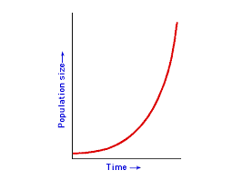
Daily Double Question
A graph like the one shown above would represent this type of growth.

Slide 43
Daily Double Answer
What is exponential growth?

Slide 44
Return

Slide 45
$200 Question
When population growth is stopped by some environmental factor, this has been reached.

Slide 46
$200 Answer
What is the population’s carrying capacity?

Slide 47
Return

Slide 48
$300 Question
This type of graph shows the distribution of various age groups in a population and is used by ecologists in predicting the likelihood of the continuation of a species.

Slide 49
$300 Answer
What is a population age structure graph?

Slide 50
Return

Slide 51
$400 Question
Lack of water in an area due to drought is an example of this of factor.
(Think about O Deer!)

Slide 52
$400 Answer
What is a limiting factor?

Slide 53
Return

Slide 54
$500 Question
These are three of the major factors leading to human population growth over the last 500 years.

Slide 55
$500 Answer
What are agriculture (farming), technology, and improved health care (medicine)?

Slide 56
Return

Slide 57
$100 Question
This includes an organism’s living place (habitat), its food sources, the time of day it is most active, and many other factors specific to that organism’s way of life.

Slide 58
$100 Answer
What is a niche?

Slide 59
Return

Slide 60
$200 Question
This symbiotic relationship benefits one organism, while the other organism is harmed.

Slide 61
$200 Answer
What is parasitism?

Slide 62
Return

Slide 63
$300 Question
If more than one species is competing for the same limited resource, this type of competition is occurring.

Slide 64
$300 Answer
What is interspecific competition?
(Quiz yourself: Do you know what intraspecific competition would mean?)

Slide 65
Return

Slide 66
$400 Question
When one organism benefits from a symbiotic relationship, and the other organism is neither helped nor harmed, this is said to be occurring.

Slide 67
$400 Answer
What is commensalism?

Slide 68
Return

Slide 69
$500 Question
If one species out-competes another for a limited resource, causing the other organism to perish, this is said to have occurred.

Slide 70
$500 Answer
What is competitive exclusion?

Slide 71
Return

Slide 72
$100 Question
When humans move a species from its native location to a new geographic area, the species is named this.

Slide 73
$100 Answer
What is an introduced species?

Slide 74
Return

Slide 75
$200 Question
Global warming is caused from in increase in heat retained by Earth’s atmosphere. This gas is known for retaining heat (thus, an increase in its normal amount leads to global warming).

Slide 76
$200 Answer
What is carbon dioxide (CO₂)?

Slide 77
Return

Slide 78
$300 Question
Damage to the ozone layer is caused by the addition of certain chemicals (like CFCs) to the atmosphere. This is why the damage occurs.

Slide 79
$300 Answer
What is because the CFCs will bond with ozone gas (O₃), removing the free ozone from the atmosphere?

Slide 80
Return

Slide 81
$400 Question
When pollutants in an organism move up the food chain to different trophic levels, this is occurring.

Slide 82
$400 Answer
What is biological magnification?

Slide 83
Return

Slide 84
$500 Question
As humans add fertilizer to the Earth’s surface, this process occurs.
(I am not looking for “fertilization.”)

Slide 85
$500 Answer
What is eutrophication?

Slide 86
Return

Slide 87
$100 Question
This encompasses the variety of life on Earth.

Slide 88
$100 Answer
What is biodiversity?

Slide 89
Return

Slide 90
$200 Question
Clearing land for agriculture, roads, and communities leads to the destruction of these.

Slide 91
$200 Answer
What are habitats?

Slide 92
Return

Slide 93
$300 Question
Scientists will attempt to balance the demands of these through questioning the needs of humans in contrast with the needs of the environment.

Slide 94
$300 Answer
What are resources?

Slide 95
Return

Slide 96
$400 Question
Hot spots refer to this.

Slide 97
$400 Answer
What are small geographic areas with high concentrations of species?

Slide 98
Return

Slide 99
$500 Question
As biologists work to develop natural resources to renew the resources being used in efforts to make resources available in the future, this is occurring.

Slide 100
$500 Answer
What is sustainable development (or planning for a sustainable future)?

Slide 101
Return

Slide 102
Final Jeopardy Topic
Population Growth

Slide 103
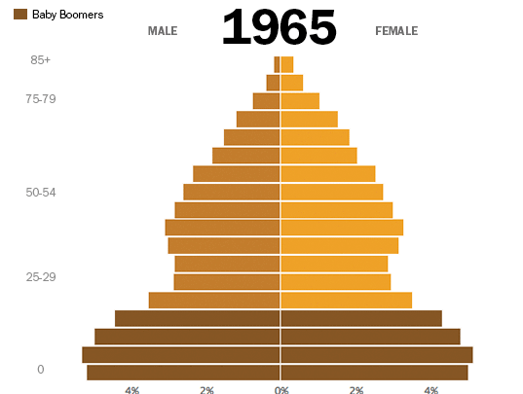
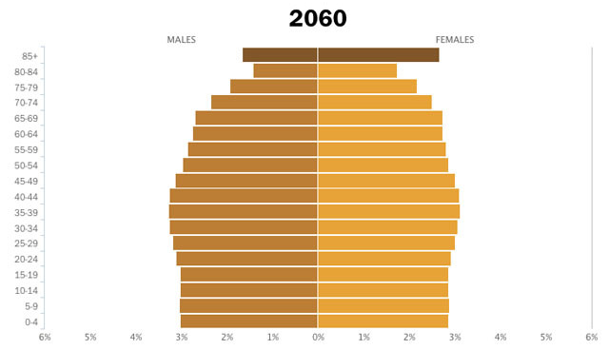
Final Jeopardy Question
Explain the demographic shift seen in the United States based on the age structure from 1960 (left) and the prediction of the age structure in 2040 (right) in the U.S. (You should base your explanation on historic events.)
1960
2040

Slide 104
Final Jeopardy Answer
What is the baby boom?

Slide 105
Thank you for playing!

